Slide 1
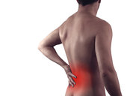
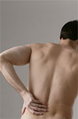
LOWER BACK PAIN
Dr.S.A.F.Kurukulasuriya
Consultant Rheumatologist
Senior Lecturer in Pharmacology
University of Kelaniya
25th Original

Slide 2
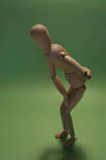
Contents
Introduction
Function of the low back
Causes of lower back pain
Investigation / Diagnosis
Management

Slide 3
Introduction
It is among the most common medical problems.
Can be among the most difficult and frustrating conditions for patients and their doctors.
Impact on productivity through loss of workers on sick leave.

Slide 4
Can be classified by its duration
Acute - < 4 weeks
Sub acute - 4 to 12 weeks
Chronic - > 12 weeks

Slide 5
Functions of the low back
Structural support- upper body when we stand
Movement- bend, extend and rotate at the waist
Protection of certain body tissues-the spinal cord, pelvic and abdominal organs

Slide 6
Risk factors
Age. Back pain is more common as you get older, starting around age 30 or 40.
Lack of exercise. Weak, unused muscles in your back and abdomen
Excess weight.
Improper lifting. Using your back instead of your legs can lead to back pain.
Psychological conditions. People prone to depression and anxiety
Smoking. This reduces blood flow to the lower spine
Arthritis and cancer

Slide 7
The red flags of back pain
Bladder / bowel involvement.
Progressive weakness of legs.
Severe back pain that occurs with other signs of illness - fever, weight loss.
Back pain after trauma.
Concomitant medical conditions- osteoporosis / multiple myeloma.
History of cancer.

Slide 8
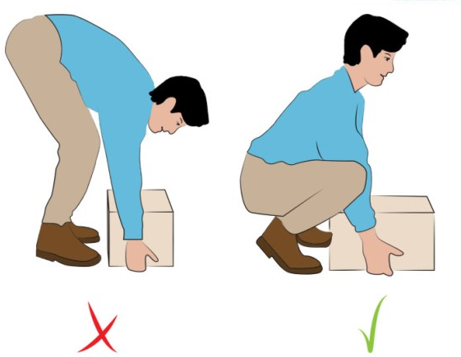
Improper lifting

Slide 9
Causes of lower back pain
Lumbar muscle strain
Lumbar radiculopathy
Bony encroachment (due to nerve irritation)
Congenital - scoliosis, spina bifida
Degenerative conditions
Injuries
Spondyloarthropathy
Pregnancy

Slide 10
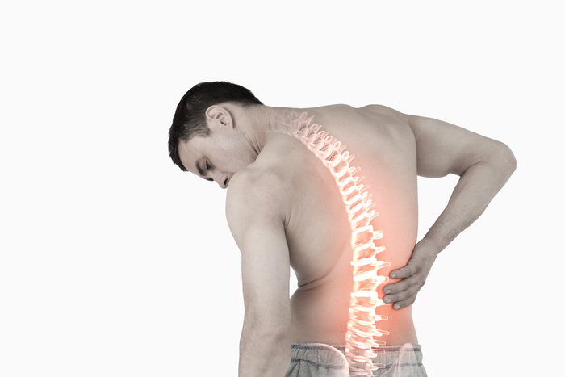
1/8 Lumbar strain
Most common cause.
Stretch injury to ligaments, tendons and muscles.
May not remember the trigger.
Most resolve completely within a few weeks.
Most often occurs in people in their forties.

Slide 11
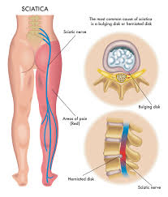
2/8 Lumbar radiculopathy
Nerve irritation/ inflammation caused by disc herniation -Degeneration / trauma / both.
Central softer part herniates and abuts the spinal nerves.
“Sciatica pain”

Slide 12
Lumbar radiculopathy contd….
“popping sensation” followed by numbness and tingling.

Slide 13
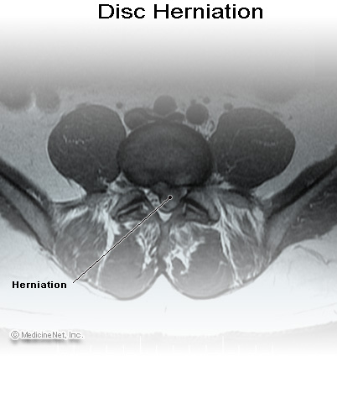


Slide 14
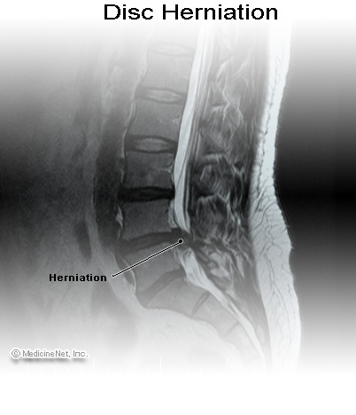

Slide 15
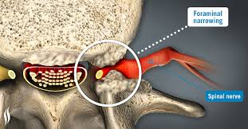
3/8 Bony encroachment
Any condition that results in movement or growth of the vertebrae of the lumbar spine.
Causes-
foraminal narrowing
Spinal stenosis
Spondylolisthesis
Pain increases with coughing and sneezing.
In severe cases bladder/bowel may be involved.

Slide 16
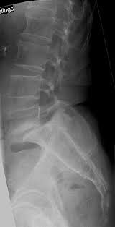
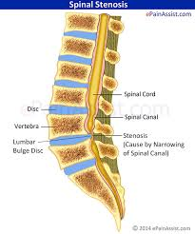
Bony encroachment contd…
Symptoms of bony encroachment -
“Sciatica”
Spinal stenosis - neurogenic claudication

Slide 17
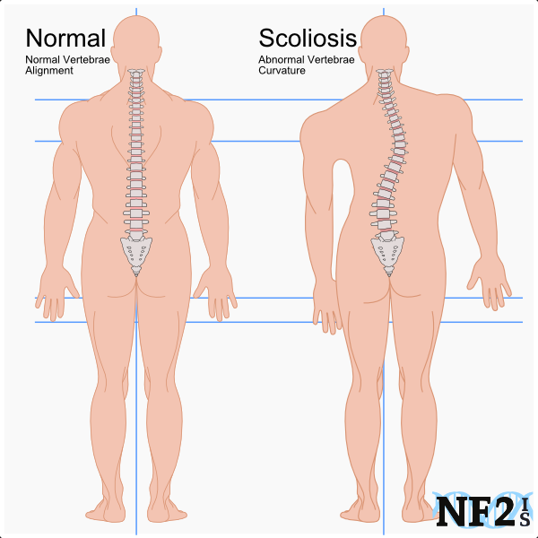
4/8 Scoliosis
Lateral curvature of the spine.
Functional - one lower extremity is shorter than the other.
True - abnormal architecture of the spine.

Slide 18
4/8 Spina bifida
Congenital defect in the vertebral arch over the spinal canal with absence of spinous processes.
Lowest lumbar vertebrae, upper sacrum.
May be associated with serious nervous abnormalities.

Slide 19
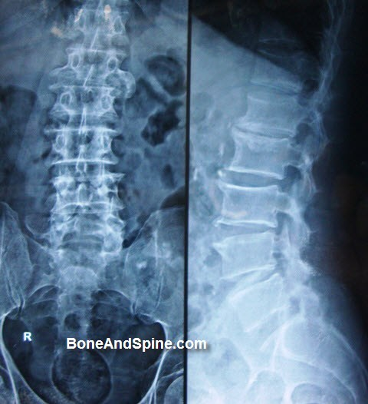
5/8 Lumbar spondylosis
Degenerative condition
Vertebral disc spaces / facet joints

Slide 20
6/8 Fractures of the lumbar spine and the sacrum
Osteoporosis (age related,long term steroids)
Trauma (RTA/convulsive seizures)
Immediate onset of severe pain that radiates around the waist, made worse with movements.

Slide 21
7/8 Spondyloarthropathies
Lower back and sacroiliac joints are affected.
Lower back pain and stiffness esp. worse in the morning
Reactive arthritis, ankylosing spondylitis, psoriatic arthritis, arthritis of IBD

Slide 22
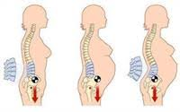
8/8 Pregnancy
50% of women.
Avoid high impact weight bearing activities.
Especially ones that asymmetrically load the involved structures - single leg stance postures.

Slide 23
Investigation/diagnosis
Lumbar strain
Based on the history of injury.
Exclusion of nervous system injury.

Slide 24
Investigation/Diagnosis
X-rays
EMG and NCV
MRI / CT scanning

Slide 25
Management aims
Exclude the red flags of back pain.
Achieve maximal reduction in pain intensity as soon as possible.
Restore the individuals ability to function in everyday activities.
Help cope with residual pain.
Assess side effects of treatment.

Slide 26
Treatment
Patient education.
Medications- Muscle relaxants, NSAIDs, neuropathic drugs, opioids.
Physiotherapy-
Heat therapy-back spasms and other conditions.
Cold compression therapy - after strenuous exercise
Exercises.
Surgery.

Slide 27
Emerging therapies
Vertebroplasty-percutaneous injection of surgical cement into vertebral bodies that have collapsed due to compression.
Specific biological inhibitors of TNF alpha may result in rapid relief of disc-related back pain.

